Slide 1
MICROSOFT MOVIE STUDIO
Dr. Jeremy Ngugi

Slide 2
INTRODUCTION
Movie industry has remained dominant in this fast paced world.
The aim of this project is to conduct an in-depth analysis of the current cinematic landscape to yield insights that will help Microsoft establish its own movie studio.

Slide 3
OBJECTIVES
Identifying successful genres that resonate with diverse audiences.
Identify top studios based on ratings.
Determine the top films to feature in the movie studio.

Slide 4
DATA UNDERSTANDING.
We used data from the following:
Box Office Mojo Links ,IMDB, Rotten Tomatoes and TheMovieDB.
These data sets contain information such as movie ratings, income generated by various studios and years of release of the various movies.

Slide 5
DATA ANALYSIS.

Slide 6
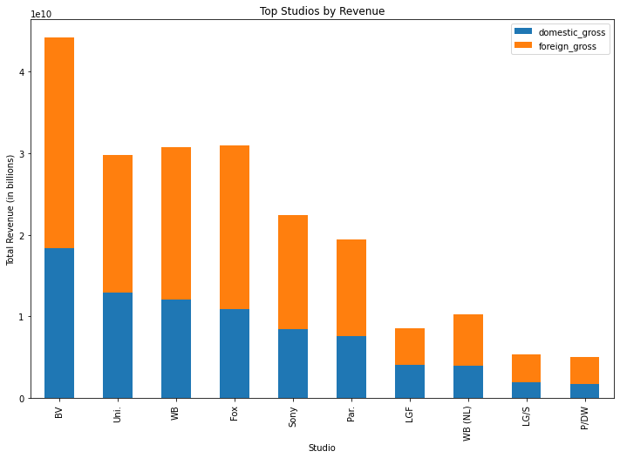
TOP STUDIOS

Slide 7
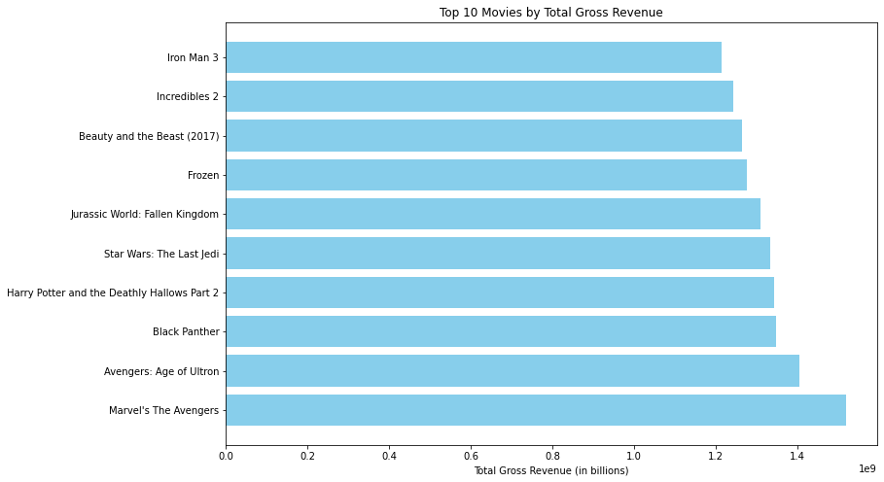
TOP MOVIES

Slide 8
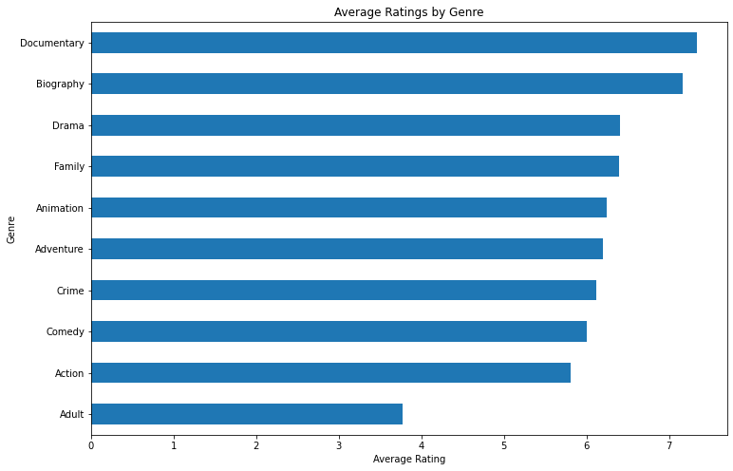
TOP GENRES

Slide 9
RECOMMENDATIONS
Consider investing in high performance movies in terms of revenue.
Invest more in documentaries, dramas and action movies because they have generated better ratings over time.
Analyze the business models, content strategies and distribution methods of top studios: BV, Universal studio and Warner Brothers Studio.

Slide 10
CONCLUSION
Any questions?
Contacts:
0799764467
ngugijeremy@gmail.com – Email
MedTechBro- Github
Dr. Jeremy Ngugi- LinkedIn

